Slide 1
School Admission One-Stop
Test cases

Slide 2
Black Box Testing

Slide 3
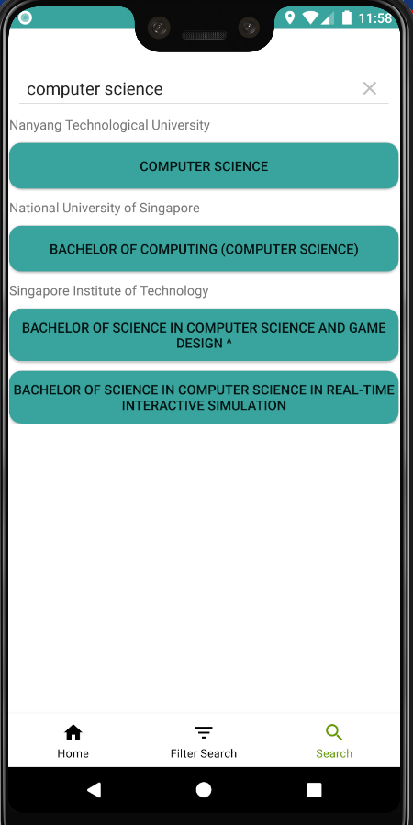
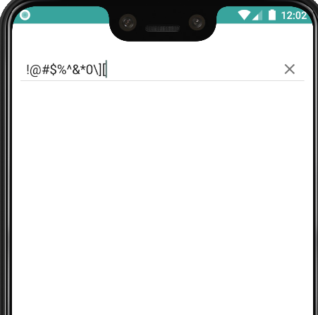
Test cases and results
The test cases are based on input into the search page of the application
Tests based on equivalence classes (valid input and invalid input)
Control Classes tested: SearchSortAlgorithm, InstituteManager, SchoolManager, CourseManager
Test Case | Input | Expected Output | Actual Output | Successful
1 | Search: “science” | List of courses from various schools with science in its name | NTU Computer Science NUS Bachelor of Computing (Computer Science) SIT Bachelor of science in computer science and game design SIT Bachelor of science in computer science in real-time interactive simulation | Yes
2 | Search: “!@#$%^&*0\][“ | No results | No results | Yes

Slide 4
White Box Testing

Slide 5
Intake Req
Start
5. Intake Requirement
DSA, Entry Req or CCA
0. Open App
6. DSA
4. Select JC
DSA
Select JC
Type of Student
1. Post Secondary
2. Post A Level/Diploma
Intake Req
7. CCA
CCA Info
8. CCA Info
3. JC
23. Intake Requirement
Select CCA
Type of institute
6. Select University
Select ITE
4. ITE
School, CCA or Intake Req
24. CCA
Select University
Select CCA
9. Select ITE
5. Polytechnic
School, CCA or Intake Req
10. Intake Requirement
26. Faculty and Schools
25. CCA Info
Select CCA
11. CCA
Intake Req
Select Polytechnic
Select School
16. Polytechnic
CCA Info
12. CCA Info
13. Faculty and Schools
27. Select School
CCA Info
Select School
17. Intake Requirement
School, CCA or Intake Req
Intake Req
Select Course
14. Select School
18. CCA
20. Faculty and Schools
Select Course
Select School
Select CCA
28. Select Course
15. Select Course
21. Select School
Course Info
19. CCA Info
Course Info
Select Course
CCA Info
22. Select Course
Course Info

Slide 6
Test cases and results
- The test cases are based on logical flow and decision making along the application’s flow map
- Control Classes tested: csvParse, InstituteManager, SchoolManager, CourseManager
Test Case | Input | Expected Output | Actual Output | Successful
1 | 0,1,3,4,6 | DSA Requirements for selected JC | DSA Requirements for selected JC | Yes
2 | 0,2,6,26,27,28 | Course Information for selected University | Course Information for selected University | Yes

